Slide 1


SAP UI5 & FIORI with OData TRAINING using BAS
Anubhav Oberoy
Day – 6

Slide 2

Agenda – Day 6
Models in SAP UI5
Model Basics
Steps to Create a Model
Data Binding
Types of Data Binding Syntax
Types of Binding
Modularization of model
Binding Modes.
Expression Binding
Concept of Named Model
How to create Named Model
Aggregation Binding

Slide 3

Model Basics
Models are object of data. All the models in SAP UI5 are characterized in two different parts:
Client-Side Model: -
Client Side Model are the models which keeps the data in the browser (client side), when app starts all the data will be loaded in one shot to the browser and kept there.
These models are used when the dataset is small and we want to manipulate data locally.
E.g. why we use internal table? – it’s a temporary store to manipulate the data and once we finalize we push data back.
Server-Side Model: -
Server Side Model are the models which keeps the data in the SAP system(server side), when app starts all the data will be loaded in one demand to the browser in a client side model from, server side model.
These models are used when the dataset is large and we want to fetch and store data back to SAP.
Imagine we have 20trillion records in our sap system, we cant access all data at once in mobile fiori app, so we use server side model to load it chunk by chunk.

Slide 4
Steps to Create a Model
There are 4 Easy Steps to Create a Model:
Step 1: Create a brand-new object of the Model
To Create JSON Model - var oModel = new sap.ui.model.json.JSONModel()
To create XML model – var oModel = new sap.ui.model.xml.XMLModel()
To create Resource model – var oModel = new sap.ui.model.resource.ResourceModel()
To create OData Model – var oModel = new sap.ui.model.odata.v2.ODataModel()
Step 2: Set or Load the data in the Model
oModel.setData({});
oModel.loadData(filePath);
Step 3: Make the model aware to the application/view
sap.ui.getCore().setModel(oModel) -- whole city knows where the gold is
this.getView().setModel(oModel) -- only the single view and its child control knows – only my family
this.getView().byId(“controlId”).setModel(oModel) -- one control have access to data – my dad
Step 4: Data Binding : It is the concept of mapping the Views and Model with which the UI knows where the data is into the model. This is done by calculating the path (address of the data).
Create object of the Model
Set/Load Data in Model
Set Model at View Level

Slide 5























Slide 6
Data Binding
Data binding is the process that establishes a connection between the application UI and business logic.
It is a bridge between a binding target(View) and a binding source(Model).
In the json data we can make address as “Every curly braces is converted to / and every array item is converted to /index”.
{"empStr": {
"empId": 0001,
"empName": "Anubhav",
"salary": 8000,
"currency": "USD"
},
"empTab": [{
"empId": 0009,
"empName": “Ananya",
"salary": 9500,
"currency": "USD“
}, {
"empId": 0010,
"empName": “Shwetha",
"salary": 10000,
"currency": “EUR"
}]}
Q: what is the salary of Anubhav
/empStr/salary
Q. What is the emp name of emp 0001
/empStr/empName
Q. What is the salary of Shwetha
/empTab/1/salary
Q. What is the empId of Ananya
/empTab/0/empId
This is the address of the data
To bind the data with the view we have to give the path of the data , so we have to use the curly braces as :
{/empStr/empName}
This is the path of the data

Slide 7
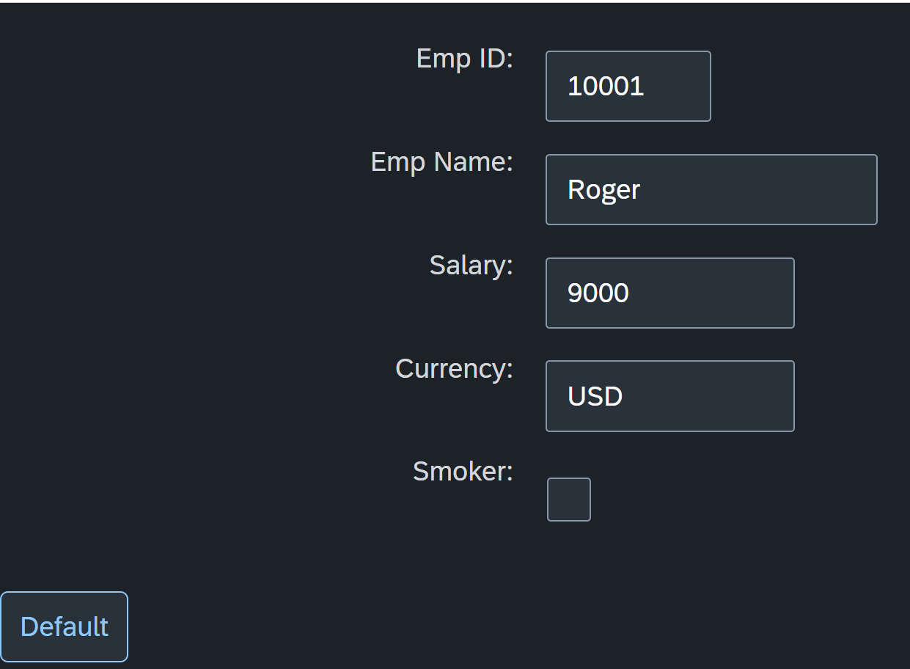
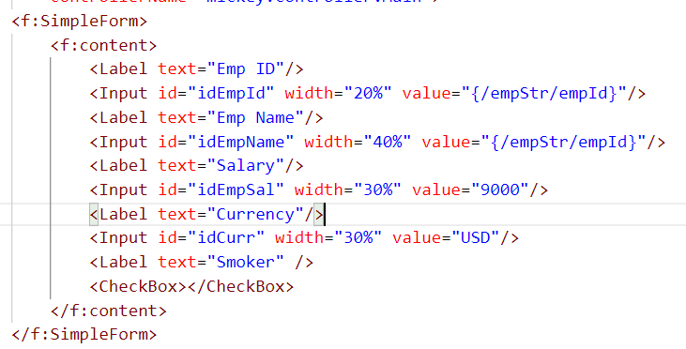
Hands – on: Create our first Model
Create a JSON model by following the steps explained in the previous Slides.
After Creating the Model bind the model to the SimpleForm using different binding Syntaxes.
Code links:-
Main.view.xml
Main.controller.js

Slide 8
Different Methods to Bind Property in View
Binding using the path of the data
{/empStr/empId}
Binding as property specific method:
this.getView().byId(‘controlId’).bindValue(‘/empStr/empSalary’)
Binding as property generic method:
this.getView().byId(‘controlId’).bindProperty(‘value’ , ‘/empStr/empSalary’ )
Binding using the path expression , this is also know as complex binding syntax
{path : ‘/empStr/empId’}
this syntax is helpful when we use formatter .
this syntax will not work by default until we inform it to the SAPUI5, to make this syntax work we have to add a line
code inside the bootstrap code of the application.
data-sap-ui-bindingSyntax= “complex”
Name of the property with which we want to bind

Slide 9
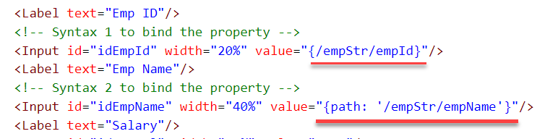
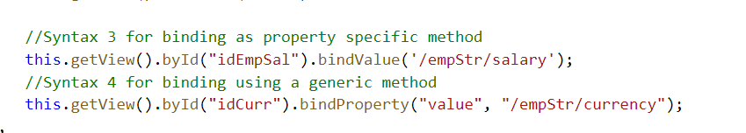
Hands – on: Binding Syntax
Now we will see the different syntax of binding the properties in the View.
Along with that we will see how to align the label and fields in the SimpleForm control.
Code Links:-
Main.view.xml
Main.controller.js
Index.html

Slide 10

Types of Binding
SAP UI5 have 4 types of Binding options:
Property Binding
Expression Binding
Aggregation Binding
Element Binding
Property Binding:-
When we bind property of a UI control, to the address/path of the model, this is called property binding. E.g., value property of Input control was connected to /emp/empId
All the four syntaxes we studied in previous slide are the example of property binding.
Ex:-
In XML view:-
<Text text=“{/emp/empId}” ></Text>
In controller: -
this.getView().byId(“controlId”).bindProperty(“text”, ‘/emp/empId’);

Slide 11
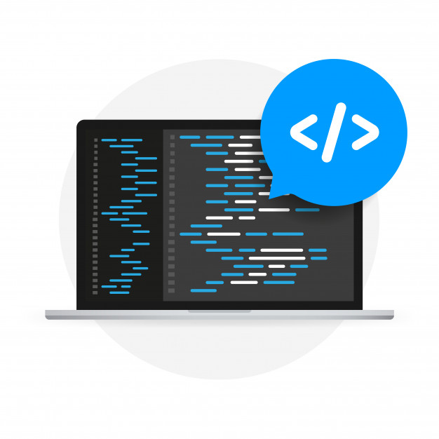
Expression Binding
Expression binding : - When we bind an Expression ({= condition ? true : false}) with the property of a control rather binding value to a property, this is called expression binding.
If we need some calculation on model data or some sort of comparison, then expression binding is useful.
Syntax:
numberState = “{= ${path} > value ? ‘conditionForTrue’ : ‘ConditionForFalse’ }”
Use Case of Expression Binding
My Manager want to add a make salary field grayed(read-only) whenever the employee name is Anubhav.
If The Employee Name is Anubhav, the salary must be 20000.
Condition – if employee name = Anubhav
Outcome – the salary must be 20000
Target – Salary field

Slide 12
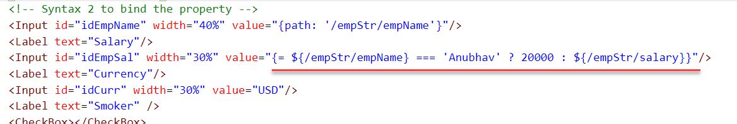
Hands – on: Expression Binding
Now we will bind the Salary field in the SimpleForm with the help of Expression binding Syntax according to the use case mentioned in the previous slide.
Before that we have to comment the line in the controller in which we are binding it form model.
Code Link:-
Main.view.xml
Main.controller.js

Slide 13
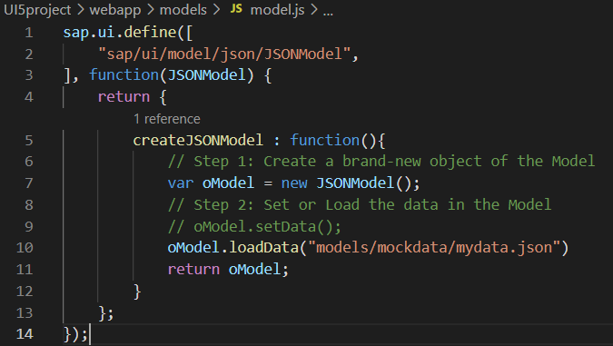
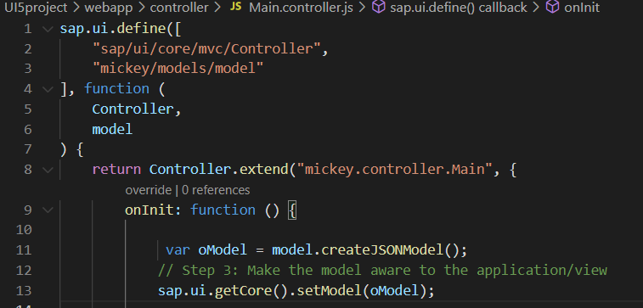
Modularization of Model
1. Create a folder in webapp with name models.
2. Inside models create a file name model.js and then create the function named createJSONModel: function(){}
3. Now create a folder inside the models named mockdata and then inside mockdata create a file named mydata.json
4. Inside the mydata.json put all the data in JSON format.
5. Then inside the models.js :-
6. Then call the model.js inside the controller and create the object then by using the object call the function of model.js
Loading the data from mydata.json using loadData() function
Call the model.js into the controller as dependency.
Object of the model.js
Call the createJSONModel function using the object

Slide 14
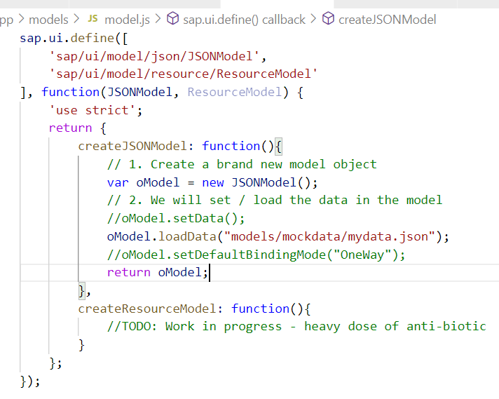
Hands – on: Modularize the Code
Now modularize our model code using the steps shown in the previous slide.
We will also see how to load the data form the model.
Code Links:-
Main.controller.js
model.js
mydata.json

Slide 15
Binding Modes
There are basically three modes of binding data in SAPUI5.
One-way binding – Here, the data is transported in one direction only, i.e., from the model, through the binding instance to the consumer (usually the property of a control), but never in the other direction. Any change done on the model data from the front end is not affected to the model. All the data changes are reflected only on the controls.
Two-way binding – Here all input changes done from front end controls are reflected on the model and the backend database. SAPUI5 automatically handles the transport of data both from the model to the controls and back from the controls to the model. It is the default binding mode.
One-time binding – Here all data will be bound from model to view just once. After that, the connection is no more set.
Data
Data
Model
View
Model
View
Data
One-way binding
Two-way binding
Data
Data
Data
Model
View
Model
View
One-Time binding

Slide 16



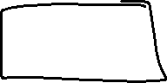






























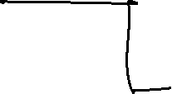









Slide 17
Concept of Named Model
Concept of named model comes into observation when we want to use more than one model simultaneously in one application. When we uses two model simultaneously the there are some conflicts arises in the application , as the second model we use will overwrite the data of the first model. So, here we use the Named Model
Creation of Named Model :
this.getView().setModel(oModel2 , “Name of the model”) ;
For example :
this.getView().setModel(oModel2 , “thanos”); → here thanos is the name of the model
Binding using the Named Model:
So in binding we use this name, to bind the data from the named model we use modelName>path in binding syntax
For example:
“{thanos>/empStr/empName}” this will bind the name from thanos model.

Slide 18
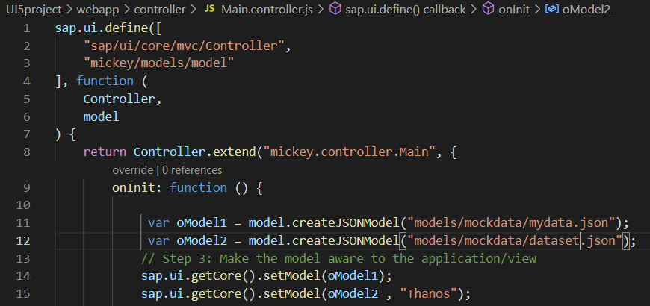
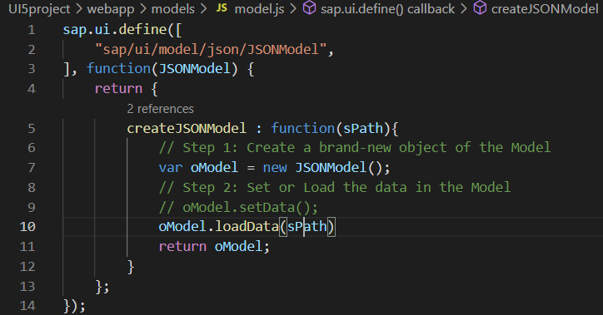
How to create a Named Model
Create a model (dataset.json) in the models folder .
In controller , we have to give the path in the createJSONModel() function
In model.js we have to pass the path as a parameter to create the model with different paths form the same function.
To bind the data in view , we have to use the name of the named model.

Slide 19
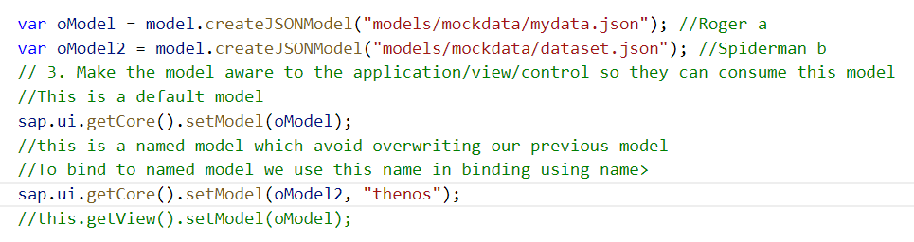
Hands-on : Creation of named model
Now we will see the concept of named model.
Code Links:-
Main.view.xml
Main.controller.js
model.js
dataset.json

Slide 20
Aggregation Binding with Table Control
When we bind the aggregation of a control with the entityset of data model, it is called aggregation Binding.
The parent control (e.g. Table) is bound to the EntitySet path which is called absolute path and the child of the parent Control (e.g. Columns) are connected to the child properties of the EntitySet is called relative path.
In aggregation binding, based on your model data, as many child controls will be created automatically.
Every Event of UI5 will trigger the eventHandler and we will get the Event Object as part of the event Handler. Depending on the event, the event handler object will have different parameters.
Use Case of Aggregation Binding
If we want to show a list or some data in tabular format, we need to bind a group of data. In such a case we will use aggregation binding.
Absolute path
{
“empTab”: [
{
“empId”: 50,
“empName”: “Jay”,
“salary”: 9500
}
]
}
Table = {/empTab}
Emp Id | Emp Name | Salary
{empId} | {empName} | {salary}
Relative Paths

Slide 21
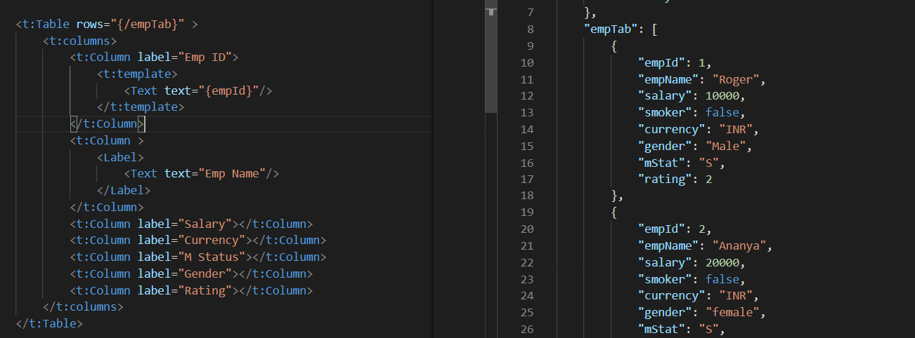
Absolute Path : Connecting parent to parent
Relative Path : connecting child to child respective to parent control

Slide 22
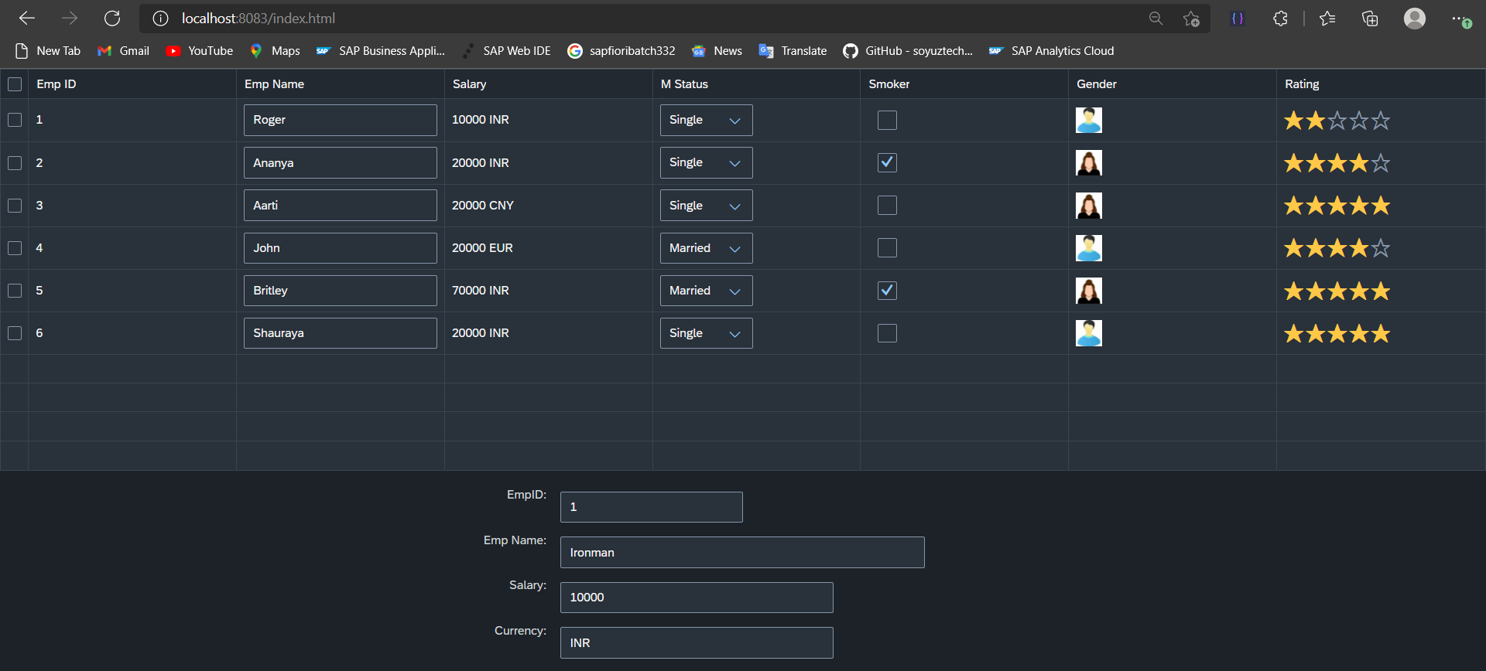
Hands – on: Aggregation Binding & Table
Now we will see how the Aggregation binding works with the help of the table control in SAP UI5.
Documentation of Table control:- https://sapui5.hana.ondemand.com/#/api/sap.ui.table.Table
Code Link:
mydata.json
Main.view.xml

Slide 23
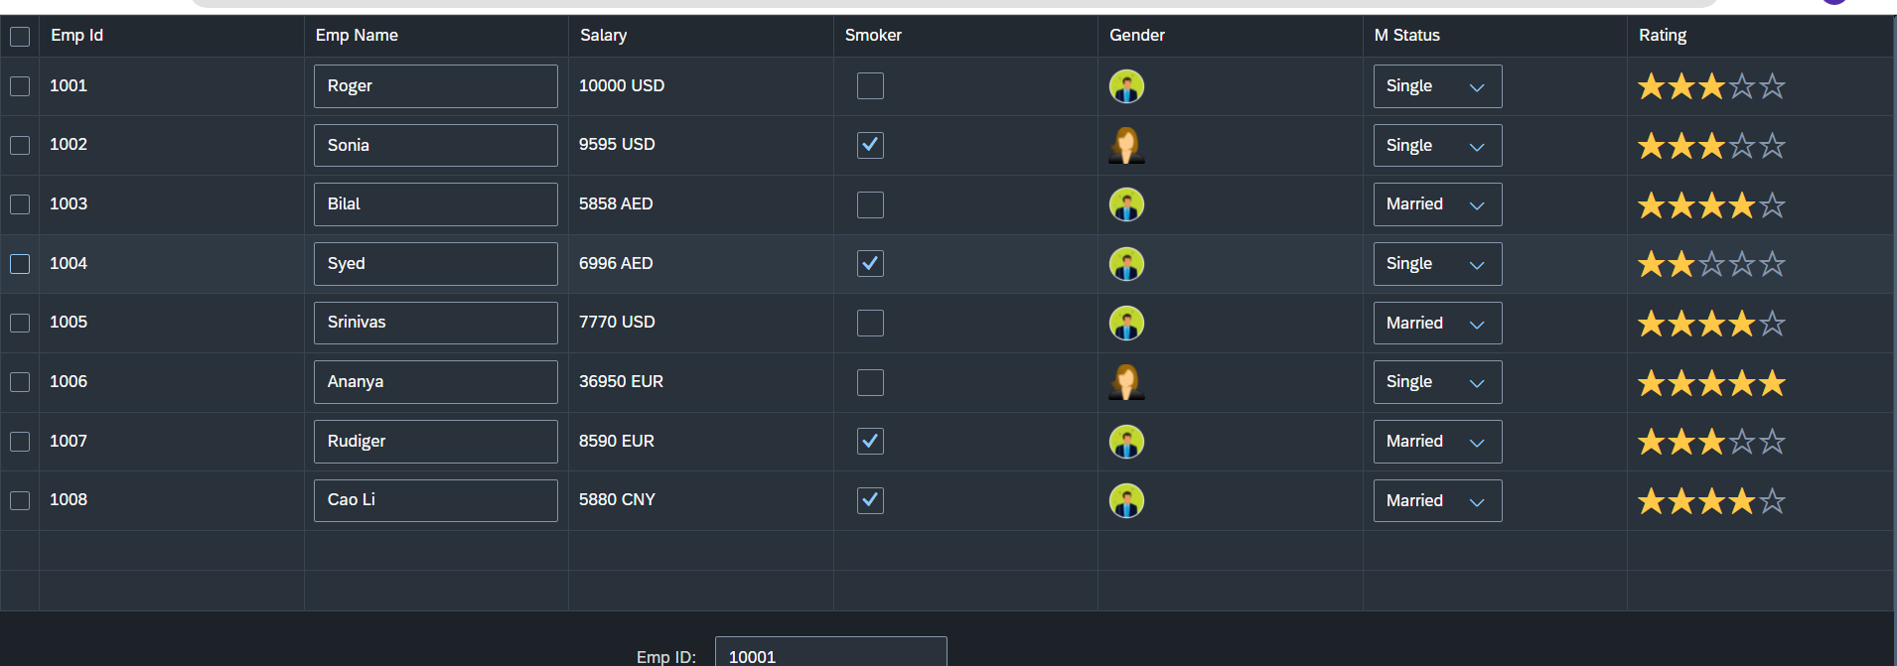
Hands – on: Table with Different Controls
Now we will add different type of controls to the UI table, like Input field, Image, Select, Rating Indicator, Check Box etc.
Code Links:-
Main.view.xml
mydata.json

Slide 24

End of Day 6

Slide 25

Questions

Slide 26

Anubhav Oberoy

Slide 27


We’re committed to empower you to be
Most Desirable Resource
through powerful training solutions.
We build the workforce of the future.
250+
Corporate Clients
30,000+
Learners Trained
25000+
Learners Placed
FREE WEBINARS
Sign up for free webinars with industry experts every fortnight!
Enroll Now!
Contact us today!
https://anubhavtrainings.com/

Slide 28




More from AnubhavTrainings.com

Slide 29
Title
Content

